Slide 1
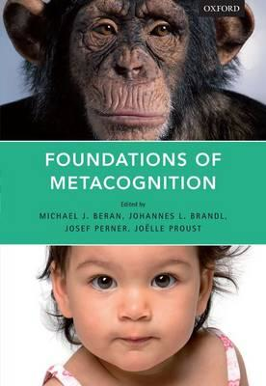



From self-evaluation to metarepresentation: two representational systems?
Joëlle Proust http://joelleproust.org
HUGHES LEBLANC LECTURES
UQAM
October 13, 2016
Notes:
Plan
Why study mc diversity?
What is the kind of diversity to expect?
metacognition has a dual aspect (see Koriat & Levy-Sadot, 1999). In experience-based metacognitive evaluation, people are relying on their noetic feelings, in particular on the felt fluency of their own engagement or of their own performance in a cognitive first-order task. In analytic mc, people rely on what they know.
One might assume that analytic mc should be more diverse than experience-based mc.
This form of metacognition is involved in distinguishing familiar from new environments, informative from repetitive messages, difficult from easy cognitive tasks. It is to be expected that experience-based metacognitive skills could be present in all cultures although they might be elicited by different first-order cognitive tasks. In concept-based metacognitive evaluation, however, an agent is trying to meet a culturally established epistemic requirement, which has been conveyed to him by explicit or implicit forms of social learning. Sensitivity to truth, epistemic authority, social consensus, evidentiality, or subjective uncertainty, then, might vary in scope as a result of a differing cultural emphasis, depending on the availability of a different conceptual and linguistic repertoire.

Slide 2
A Puzzle
There is evidence that non-human animals that have not evolved a mindreading capacity, such as macaques and non-primate species, such as rodents, are nevertheless able to appropriately evaluate their self-confidence level in perceptual and memory tasks.
Self-knowledge, however, seems to require some form of embedding a representation into another, i.e. metarepresenting one's own states, as exemplified in mindreading.
Notes:
Il est intéressant d'examiner toutes les hypothèses qu ont été examinées pour résoudre le problème; certanes impliquent des conceptions nouvelles sur l'évolution de l'esprit, le rôle du contenu non-conceptuel dans la connaissance de soi, les fondements de la décision rationnelle, et sur l'état de l'épistémologie. Nous allons tenter de résumer l'état de l'art et d'articuler une nouvelle proposition concernant les propriétés de la nature et sémantiques de métacognition chez les non-humains et chez les humains.

Slide 3
Central examples of animal or human metacognition
Prospective monitoring (evaluating one’s ability to carry out a cognitive task)
  Feeling of knowing
  Tip of the tongue
Retrospective monitoring (judging the adequacy of a response)
judgments of learning (reducing uncertainty on time needed to learn)
Monitoring emotions & motivations (social purposes).

Slide 4
Problem made more difficult by disunified terminology
In experimental psychology, “metacognition” refers to the capacity through which a subject can evaluate the feasibility or satisfactory completion of a given mental goal (such as remembering a name, or discriminating a signal) in a given case (Koriat et al., 2006).
« Self-evaluative » view
Mindreading specialists from developmental psychology and philosophy take metacognition to refer to first-person metarepresentation of one's own mental states (Carruthers 2009, 2011, Perner, 2012).
→ « Self-attributive » view
Notes:
Meta dit on souvent signifie« être au sujet de"." Métacognition "= la connaissance à propos de sa propre cognition,« penser sur sa propre pensée », ou, en bref, de méta-connaissances. Cette terminologie doit son influence aux premiers travaux sur les relations entre les aspects de contrôle et monitoring de la métamémoire tels que Hart, et à la conception métareprésentationnel de John Flavell de métacognition chez les enfants dont Perner a lui-même approuvé.
Pour les philosophes, cette acception de la métacognition est conforme à des vues profondément ancrées sur le caractère exclusivement humain de la rationalité.

Slide 5
Not a terminological matter
The issue is evolutionary, developmental and functional:
  Is mindreading a causal prerequisite and/or a constitutive part of metacognition?
  Is rather metacognition a prerequisite and/or a constitutive part of mindreading?

Slide 6
Not a terminological matter
Also a philosophical issue:
  is self-knowledge primarily of a “theoretical” kind ?
  Does self-knowledge depend in part on non-conceptual content?
  Has epistemic sensitivity primarily to do with mental action or with self-attribution?
Notes:
LA TERMINOLOGIE DEVRAIT SUIVRE ET NON DEVANCER LA RECHERCHE.

Slide 7
Outline
Experimental evidence for non-human metacognition
Hypothesis 1: metacognition as meta-knowledge
Hypothesis 2: no metacognition
Hypothesis 3: Metacognition as activity-based evaluation
Conclusion

Slide 8
Experimental evidence for non-human metacognition
3 main experimental paradigms (behavior/brain)
Seek information before acting? (Call 2010) or obtain it from a helper at a cost? (Hampton, 2009)
Choose/decline to perform a task of various difficulty?
  Smith et al 2008: visual discrimination
  Kepecs et al. 2008, 2012): olfactory discrimination
  Hampton 2001: memory retrieval of paired items
Wager on previous cognitive decision? (Kornell et al. 2007).

Slide 9
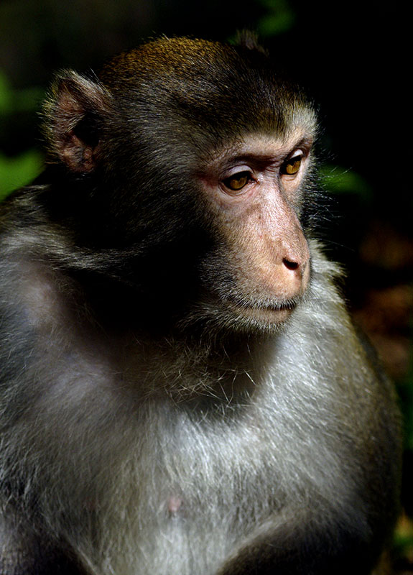
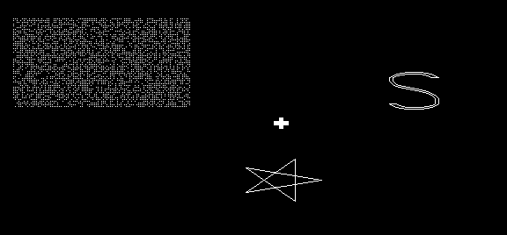

Slide 10
Smith and/or coll. on metacognition in monkeys
Rhesus monkeys decline most the most difficult trials in visual discrimination tasks (Shield, Smith & Washburn, 1997) and in memory tasks (Hampton, 2001).
They generalize their U- responses to new tasks. (Washburn, Smith & Shields, 2006)
Macaques also use U-responses with blocked feedback (Beran, Smith, Redford & Washburn, 2006)

Slide 11

Monkey
100
90
Sparse
80
Dense
70
60
50
40
30
20
Uncertain
10
0
1250
1650
2050
2450
2850
Box Density (pixels)
Humans
100
Sparse
90
80
Dense
70
60
50
40
30
20
Uncertain
10
0
1250
1650
2050
2450
2850
Box Density (normalized pixels)

Slide 12
Metacognition in Phylogeny:
Yes No
Pigeons U-R opt out (Adams & Santi 2011)
Rats: Foote & Crystal (2007); Kepecs et al (2008) U-R
Capuchin monkeys: U-R (Fujita 2009)
Rhesus macaques (SI & U-R) (Smith et al, Kornell, Hampton))
Bottle-nosed dolphins U-R (Smith)
Chimps and orangutans (SI) and UR (Suda-King 2008)
Pigeons no U-R (Sutton & Shettleworth, 2008)
Rats: Smith & Scholl (unpub.), Smith et al. 2007 (no U-R)
Capuchin monkeys: no SI, no U-R (Beran et al. 2006)

Slide 13

Hypothesis 1
Metacognition as metaknowledge

Slide 14
Hypothesis 1 from comparatists
Metacognitive animals have a disposition to know that they themselves are in a given mental state, for example that they are trying to remember whether they have perceived a given stimulus in a prior occasion.
"Knowing that", by definition, has propositional content.

Slide 15
As a consequence, embedded contents should require
Embedding attitude concepts
Reference to oneself as the target knower.

Slide 16
Three main arguments
Prospective judgments of uncertainty formed in the absence of the primary test stimuli, "constitute a strict test of the hypothesis that the metacognitive judgment is based on introspection directed at explicit mental representations"
Retrospective judgments of confidence, especially when they immediately transfer from one task to another, "suggest that not only is the animal motivated to avoid penalized responses, but also that it can report knowledge of its state of uncertainty"

Slide 17
Three main arguments
Given the similarity of pattern in uncertainty responses in humans and in rhesus monkeys, a metarepresentational account is as justified in the second case as it is in the first

Slide 18
Four questions & answers
Informational source?
  Higher-order awareness
Nature of opt out-decision ?
  Epistemic
What motivates decision?
  Judgment of uncertainty
Type of learning?
  Inference

Slide 19
Objections to Argument 1
"Prospective judgments of uncertainty formed in the absence of the primary test stimuli, "constitute a strict test of the hypothesis that the metacognitive judgment is based on introspection directed at explicit mental representations".
Do the animals need to form "judgments of uncertainty"?
What exactly are the representations that the animal "introspects" in order to judge?
What is the evidence for these representations being "explicit",rather than "implicit"?

Slide 20
Objections to Argument 2
Retrospective judgments of confidence, especially when they immediately transfer from one task to another, "suggest that not only is the animal motivated to avoid penalized responses, but also that it can report knowledge of its state of uncertainty"
Reportlikeness of the responses are a paradigm effect: the animals don't report what they know, because reporting a state of affairs is not a speech act they are disposed to perform.
They, rather, express their uncertainty by deciding to include or reject the test in their final score.

Slide 21
Objections to Argument 3
"Given the similarity of pattern in uncertainty responses in humans and in rhesus monkeys, a metarepresentational account is as justified in the second case as it is in the first".
Suppose that humans need to form metarepresentations about their mental states to experience/use uncertainty in guiding their act.
How might non-mindreaders metarepresent their own mental states?
From the similarity of pattern, what can be concluded is only that a similar kind of information is available to humans and to rhesus monkeys, rodents, etc. to assess their own uncertainty.

Slide 22
Objections to Argument 3
Might animals metarepresent only their own mental states? This would infringe the generality principle as applied to mental-state concepts.
Can metarepresentations be formed in the absence of attitude concepts, with indexical concepts referring to nonconceptual patterns of experience? This proposal is incompatible with the structure of MR as embedding a proposition within another.
From the similarity of pattern, what can only be concluded is that a similar kind of information is available to non humans and to rhesus monkeys, rodents, etc. for assessing their own uncertainty.

Slide 23
Hypothesis 2
The no- metacognition view

Slide 24
This view is defended in two versions:
  Associative accounts
  Executive accounts

Slide 25
Associative accounts
Informational source?
  Behavioral cues
Nature of opt out-decision ?
  Response conditional on anticipated reward/penalty
What motivates decision?
  payoff
Type of learning?
  Operant conditioning

Slide 26
First-order associationism: The information that animals use when performing tasks qualified as "metacognitive" are of a behavioral nature
Opting out, and the other tasks reviewed above, can be solved on the basis of operant conditioning (Le Pelley 2014)
An animal’s willingness to opt out from a cognitive task depends on representing a state of the world as worth producing, rather than on an internal evaluation of the agent's own uncertainty.

Slide 27
4 difficulties
Suppression of direct reinforcement does not influence metacognition (Smith et al. 2006)
The difference observed between trials with free and forced cognitive decisions shows that animals are sensitive to endogenous cues rather than merely to states of the world. (Hampton, 2001, Smith et al. 2014)

Slide 28
4 difficulties
Computer simulations based on behavioral cues have failed to track MC response patterns (Smith et al. 2008, 2014).
Single cell recordings in rats and monkeys show that the cues guiding decision are unrelated to
    Stimulus
    behavior,

Slide 29
The most compelling study involves a post-decision report of confidence, which collects, in contrast with an opt-out paradigm, both
an answer to the first-order cognitive task and
a confidence evaluation
in each trial (Kepecs and Mainen, 2012).

Slide 30
  This computational/behavioral/neuroscientific analysis identifies the activity-dependent neural cues (patterns of cues) that are used by animals to predict epistemic outcome for a decision.`
  Other cues are used to predict reward.
  (Kiani & Shadlen 2009, Kepecs & Mainen (2012).

Slide 31
Alternative: Executive accounts
Def: Executive capacities are involved in selecting a behavior as a function of one's goal, in inhibiting it, shifting it, and updating it.
On this view, the information that animals use when performing tasks wrongly called "metacognitive" are of an appetitive nature (based on feelings anticipating reward or cost).
Carruthers & Ritchie (2012)

Slide 32
Executive accounts
Informational source?
  Emotions
Nature of opt out-decision ?
  Executive control based on anticipated reward/penalty
What motivates decision?
  payoff
Type of learning?
  Reinforcement learning
Notes:
Emotions veersus behavioral cues
Executive control vrsus stimus-response

Slide 33
Is MC an executive, goal-driven ability?
Grain of truth: mc requires control, ie ability to select a cognitive action (mediating an action on the world).
Incentive affects the amount of effort expended, hence likely success.
--> But metacognitive control is not merely driven by the distal goal.

Slide 34
MC is also data-driven
Subjective feedback from the task similarly affects decision across incentive levels. (Koriat et al. 2006, 2014)
→ incentive-based control and cognitive monitoring (data-driven confidence) have each their separate independent effect on mc. (Zakrzewski et al. 2014)

Slide 35
Hypothesis 3
The epistemic- evaluative view

Slide 36
In yellow: crucial differences between
Associative & executive accounts
Epistemic-evaluative accounts
Informational source?
  Behavioral cues or emotions
Nature of opt out-decision ?
  Response conditional on anticipated reward/penalty
What motivates decision?
  payoff
Type of learning?
  Operant conditioning/reinforcement learning
Informational source?
  Emotions
Nature of opt out-decision?
  Epistemic monitoring
What motivates decision?
  Quality of information + payoff
Type of learning?
  Reinforcement learning for informational prediction and recalibration

Slide 37
This proposal is an elaboration of Asher Koriat’s theory of human metacognition (Koriat & Levy-Sadot, 1999)
Metacognitive evaluations are either
“experience-based” , i.e. constitutively involve noetic feelings, such as the feeling of ease of processing, or the feeling of knowing
→ Procedural, or implicit metacognition (system 1)
“concept-based”, i.e., constitutively involve various kinds of beliefs about task, own competence, etc.
→ Analytic, or concept-based metacognition (system 2)
See also: Jacoby & Brooks (1984), Schwarz (2004)

Slide 38
An animal ‘experience-based’ evaluation?
Several authors (philosophers and psychologists) have hypothesized that an evaluative, nonconceptual, affect-based mode of representation is shared by humans and nonhumans.

Slide 39
Bermudez's frames (2009),
Cussins' NASAS, (2012),
Dreyfus & Kelly's affordance sensings, (2007),
Gawronski & Bodenhausen's associative evaluations (2006),
Gendler's aliefs, (2008),
Griffiths & Scarantino's emotional representations (2009),
Millikan’s pushmipullyu representations (1995)
Nanay's pragmatic representations, (2013).
Strawson’s feature placings (1959)

Slide 40
Commonalities of these proposals
These representations are based on predictive cues and associated feelings.
Their function is to guide action.
They have an associative rather than a propositional structure.
They are relational and subjective rather than detached and objective.

Slide 41
The semantic structure of evaluative attitudes (affordance sensings)
Affordance_{a} [Place=here],[Time= Now/soon],
[Valence_{a}],
[Intensity_{a} (on a scale 0 to 1)],
[motivation of degree_{d} to act according to action program_{a}].
All the constituents are associatively related to perceptual cues in the affordance sensing
→ A subset may activate the full representation and thus predict an opportunity

Slide 42
Evaluative vs propositional attitudes
No contrast between an object and a concept
No combinatorial ability
No deductive power
No embedding possible
But still structure:
Predictive ability connected with reactive action schemas
Graded sensitivity to affordances
Graded « control precedence »

Slide 43
Noetic feelings express cognitive affordance sensings
Affordance _{familiar/ rememberable,} _{clear..}
[Time]= now
[Valence_{a}]_{, positive}
[Intensity_{a} (_{on a scale 0 to 1})],
[motivation to act of degree_{d} according to action program_{a}]. _{Identify! Remember! Accept!}

Slide 44
How does it work?
Animals and humans extract predictive information from the "neural signature" of the activity elicited by a cognitive task
Processing onset,
intensity ( amplitude of activation)
coherence of cognitive activity over time
Latency to reach threshold (fluency)
These cues are part of an affordance sensing, predicting likely cognitive success of a given epistemic decision.

Slide 45
In summary: noetic feelings
Express a relation, not a state of affairs
Indicate a subjectively relevant condition and motivate an action
Are evaluative and graded
Nonpropositional
Do not conceptualize, but categorize affordances by mere associative pattern matching

Slide 46
Conclusion

Slide 47
Evolutionary relevance
Coming back to our initial questions:
  Is mindreading a causal prerequisite and/or a constitutive part of metacognition?
  → A sensitivity to one's own epistemic reliability does not require mindreading as a causal or intentional prerequisite.
  see Kim, S., Paulus, M., Sodian, B., & Proust, J. (2016). Young Children’s Sensitivity to Their Own Ignorance in Informing Others.
→ Metacognition may rather be a constitutve ingredient in the complex ability that is called "mindreading"

Slide 48
Philosophical relevance
  Epistemic sensitivity has to do with the control of one's own cognitive actions. The early forms of self-knowledge are a know-how, rather than a know-that
  Concept-based self-attribution of epistemic attitudes and properties (such as "I believe that") presuppose affect-based self-evaluation.
  Even the higher forms of epistemic deliberation and theorizing might still largely depend on experience-based metacognition.

Slide 49
A Dual-System view of MC
What Developmental and phylogenetic dissociations suggest:
A basic mc system has the function of forming (not reporting) evaluative attitudes (common to humans and some nonhumans)
A more recently evolved system has the function of forming, reporting and updating propositional attitudes, ie justifying one’s decisions. (<humans only)
Reporting of propositional attitudes is vital for scientific, legal and formal social contexts.
Functionally speaking, it is the top of the iceberg.

Slide 50
Thanks for your attention!

Slide 51
Questions welcome!
Article download: http://joelleproust.org

Slide 52
A Dual-store view of MC
Developmental and phylogenetic dissociations
One system has the function of expressing and reporting propositional attitudes, ie justifying one’s decisions. (<humans only)
Another has the function of expressing (not reporting) evaluative attitudes (<Humans and nonhumans)

Slide 53
4 possible ways of interpreting a response in a context of uncertainty:
Property of the stimulus relative to the frequency range of the stimulus class:
Middle range is objectively uncertain
middle range responses are directly rewarded (+ cond.)
middle range responses are directly punished (- cond)
Middle range is subjectively uncertain: ie not bound to stimulus or to R-conditioning

Slide 54
In favor of interpretation 4
The properties of the observed responses
Are not just cognitive, ie. not stimulus-bound
They generalize to new stimuli and new tasks without new learning (Kornell & al, 2007)
Distinctive pattern: « fragile & changeable », also in humans.
They suppose access to a metacognitive feeling - e.g. a feeling of uncertainty

Slide 55
Main recent findings
New World monkeys (capuchins) learn middle responses when selectively rewarded but don’t produce metacognitive responses (ie, don’t use the “?” response) when given no feedback, in contrast with Old World monkeys (rhesus monkeys).
There is a dissociation between the U-responses and the middle responses; they differ in motivational strength.

Slide 56
Metarepresentation Metacognition
EssentiallyReflexive
Engaged processing (simulation)
Poorly recursive
No decoupling
Representational promiscuity
No inferential promiscuity
Predictive-evaluative function
No essential reflexivity
Disengaged processing (shallowness possible)
Fully recursive
Decoupling involved
No representational promiscuity
Inferential promiscuity
Predictive-attributive function

